Slide 1

Food Based Social Media Application

Slide 2
Content
Introduction.
Targeted Audience
Problem Definition
Proposed Solution
Sneak Peak into Application

Slide 3



Introduction
Food is the basic human need to stay alive. Moreover, it is the need of every living organism.
Nowadays food has become trending among the society, because of that people are willing to try a different kind of dishes.
Social media can be a divisive place but if there’s one thing that unites us all, it’s food.
Therefore, it is better to have a social platform that allows to sell, buy, and share their food ideas.
Not only that, but we can also keep our focus on restaurants to expand their marketplace, content-creators who create food recipes, people who are willing to sell their cooking skills and all other food lovers.

Slide 4




Targeted Audience
We can keep our focus on restaurants to expand their marketplace.
Young generation likes to try out various tastes.
Content-creators who create food recipes.
People who are willing to sell their cooking skill and all other food lovers.

Slide 5



Problem Definition
Many people are accustomed to using social media to share food related content, but a food only platform has not yet emerged.
Not only that but there is also a lack of a social platform that provides all buying, selling, hiring, sharing food related things in one place. Only a unique task can be done through existing social media or mobile apps.
We can elaborate on the sub-problems we have identified as social media platforms do not have a proper video conferencing feature. If someone wants to hold a video conference, they must use Zoom, MS Teams, Google Meet or any other server that supports video conferencing.

Slide 6
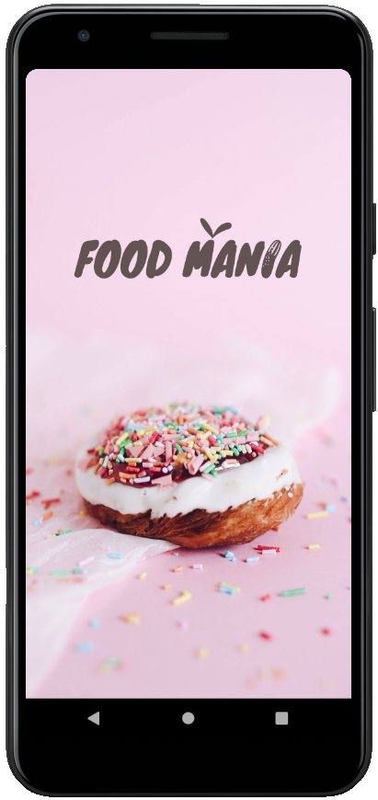
Proposed Solution
We had developed an android application called “Food Mania” which allows us to create accounts and share recipes, businesses, photos, stories, videos, and cooking skills with the friends and followers you care about.
Users can share their knowledge by holding video conference meeting sessions. It not only creates a culture of a more collaborative meeting between food-loving communities but is also the basis for activating the current digital workforce.
Therefore, “Food Mania” will be a great hit among the society in near future.

Slide 7
Market Analysis
Gathering information about the state of the market
Marketing Strategy
It makes a bridge that allows your product to fall into the hands of your customers
Competitors
Creating a competitive analysis to understand the other competitors and their strengths and weaknesses.
Company Overview
Business
Plan
- Type of business structure - Team/remote team
- Problem and mission - Statement of the concept
Financial
The financial model includes, as a rule, a three- to five-year forecast of all the main forecasted models, including profit and loss, cash flow, balance sheets, start tables, and valuation.

Slide 8
Main Objectives
Show off the skills by uploading our own cooking and baking recipes to share with our international community.
Be inspired daily by thousands of free food recipes, tips, and articles and have a taste of home.
Learn how to cook – become a kitchen pro with instructional video conferences and skill tutorials.
Setup the personal profile and upload photos of the dishes we’ve cooked and exchange cooking experiences with others
By conducting video conferencing and chat feature will allow users to share their knowledge with other food lovers, and it will make a huge platform for a collaborative community.
Hire a skill seller such as a chef, cake baker and many more, by using the location.

Slide 9
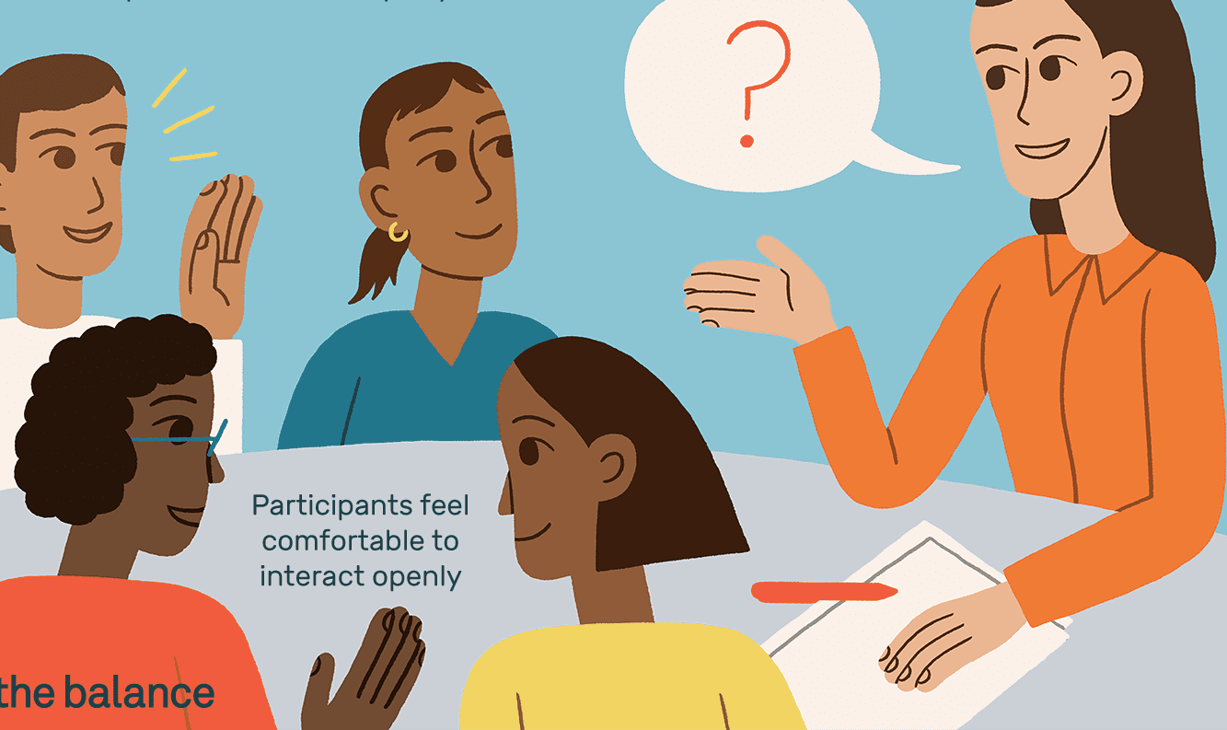
Data Collection Methods
Interviews
We are unable to meet the person due to this pandemic situation we go for a telephonic interview.
We ask questions through telephones such as their idea about food-related social media platforms and the favoritism of sharing food-related things to be able to exchange their knowledge with others.
Documents and Records
We have done extensive research on your competitors and similar application. It is efficient and inexpensive because we’re predominantly using research that has already been completed.
We collect and use data contained in web articles (scientific study) to gain a proper understanding of the current social media impact of food.

Slide 10
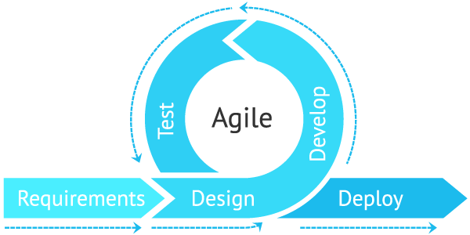
Software Process
Model
The agile process model encourages continuous iterations of development and testing. Each incremental part is developed over an iteration, and each iteration is designed to be small and manageable so it can be completed within a few weeks.
It helps us to focus on fully implementing each small feature set. Plus, it considers that the system evolves through a series of short iterations if the requirements will change.
Scrum is our basic methodology. Scrum consists of iterations called sprints. Each sprint is between 2 to 4 weeks long and is preceded by planning. We assign a specific task in each sprint among our team members.
Requirements, design, development, testing, and deployment are the main steps we have taken. It improves team performance based on real-time, visual data that our team can use.

Slide 11






Software Development Tools
Database –
My SQL version 5.0
Front End – Android Studio version 4.2 with android retrofit (2)
Admin UI –
Html 5, CSS, Java Scripts
Backend – Laravel based PHP version 7.4

Slide 12
Sneak Peek into

Slide 13

How It Flows..
Loading Screen
The most important thing is the first impression.
Our opening window of the “Food Mania” android application, looks like this.

Slide 14
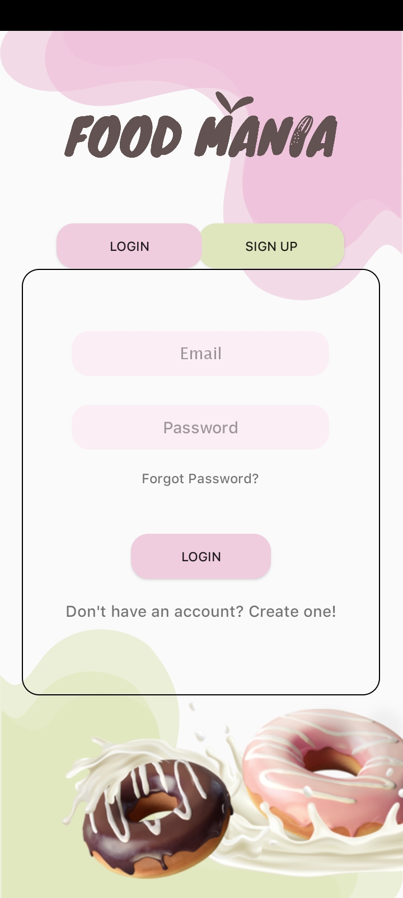
User Login
This UI is designed as the login page for the “Food Mania” android application.
Users can enter their email and password to log in to the system. And there is an option called ‘Show password’ when clicking on it, they can see their entered password

Slide 15
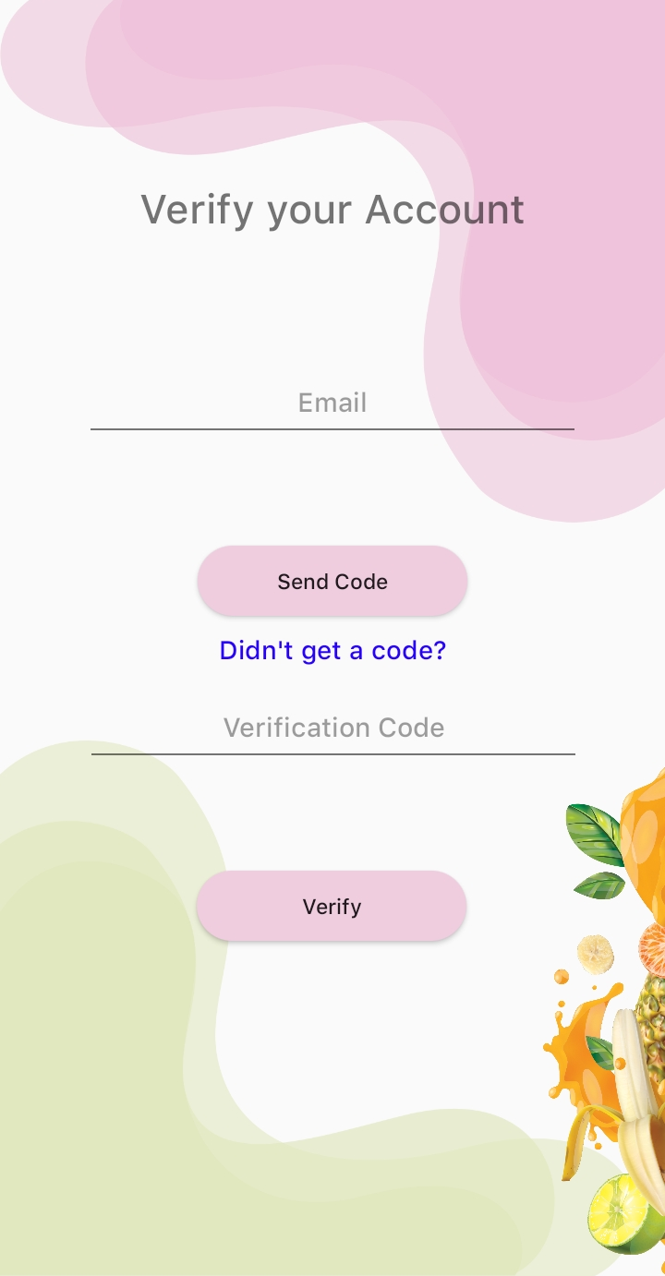
Did you forget your password?
If the user ever forgets his/ her password, he/she can use this “Forgot password” option to recover the password.
There you can enter your email address and it will send an auto generated vitrification code to your email.
If you did not get the verification code, you can click “Didn’t get a code?” option to resend the code.

Slide 16
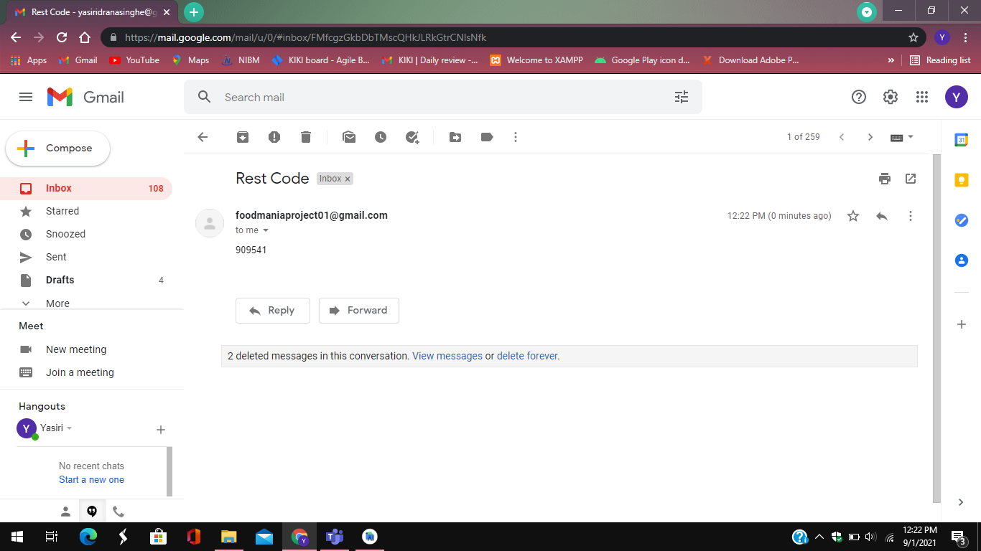
Verify ?
Verification code is received to the e mail. Entering that code will enable you to recover your password.
After entering the verification code, it will redirect to the reset password screen and then users can enter a new password to log in to the system.

Slide 17
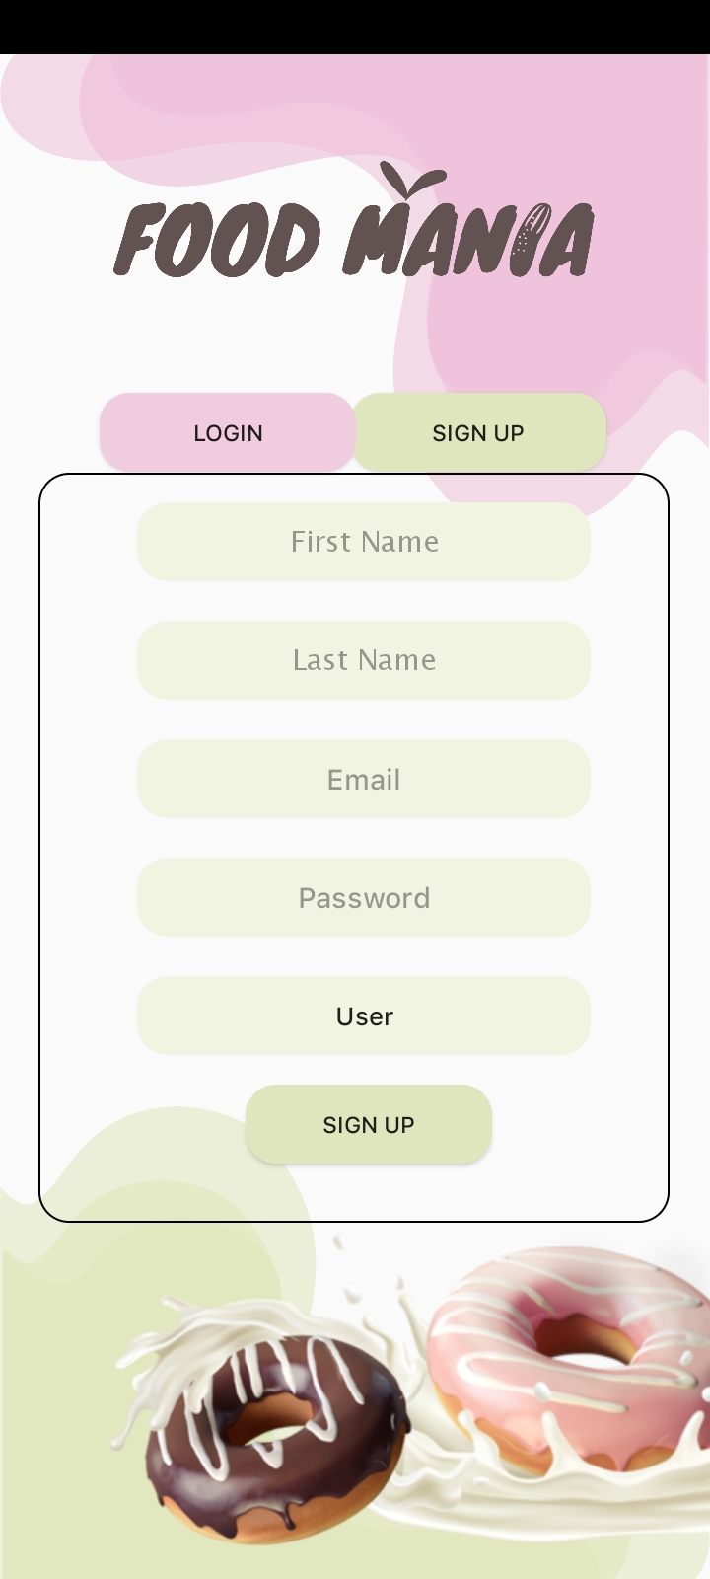
User Registration
Are you a new user ?
New users can enter their details to be able to make their user profiles.
Here users can select their user categories (User, Skill seller, Restaurant)

Slide 18
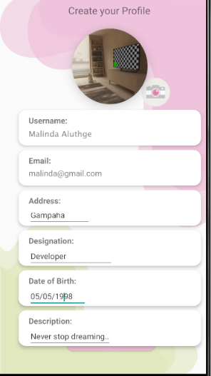
Create your own profile
After registering, users can create their user account by adding a profile picture, description, address, designation, DOB, etc.

Slide 19
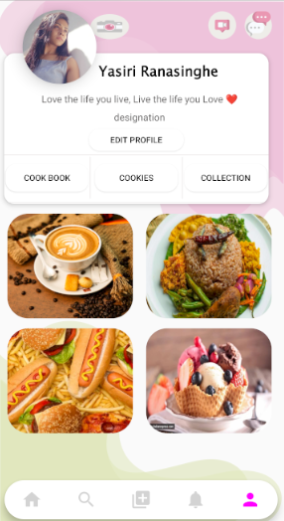
User’s Profile
This I shows the user’s account. It is having user details and 3 fragments such as Edit Profile, Cookbook, Cookies, Collection. Cookbook shows the posts that we added to our profile, the collection is holding the saved posts and cookies are known as friends.

Slide 20
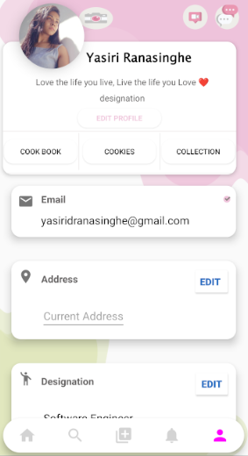
Do you want to edit your profile?
Users can edit their profile details

Slide 21
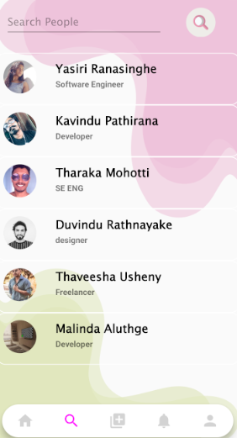
Search People
Users can search for other users by entering their username in the given search box.
By clicking on the searched user’s name, it will redirect to the relevant user’s account.

Slide 22
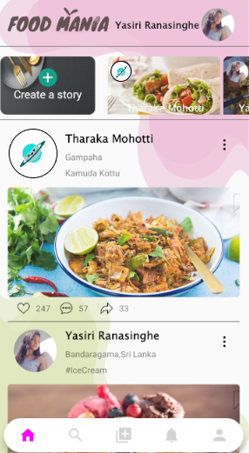
News Feed
News Feed is constantly updating the list of stories in the middle of the home page.
It includes posts, recipes, links from people you follow on Food Mania.

Slide 23
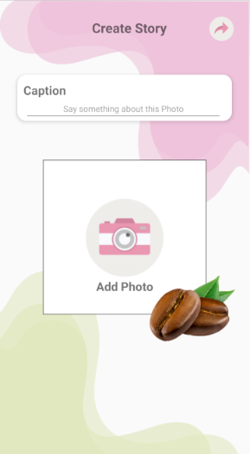
Create a Story
On the top of the news feed, there is a feature called “create story”.
By clicking the plus button, it will allow adding a story (status) from your profile.

Slide 24
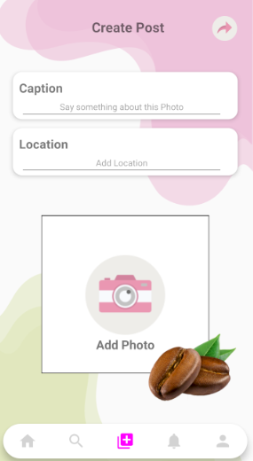
Create a Post
Users can add posts with a caption and location from this UI.
By clicking the “plus button” it will open your files to be able to browse and select the post that you need to share.

Slide 25
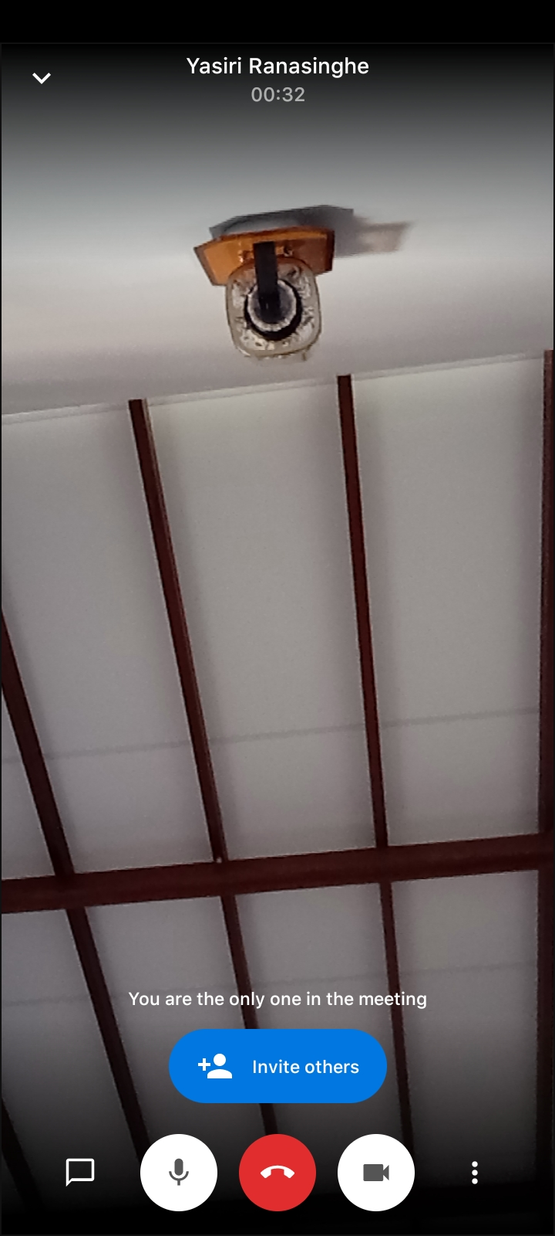
Video Streaming
By clicking on the video button which locates on top of the user profile, it will redirect to the video streaming platform.
We can add other users to this call and at the same time we can invite friends via
an invite link.

Slide 26
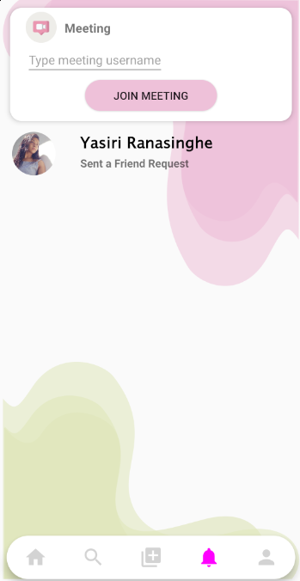
Notifications and Join Meeting Option
Users will get notifications to this tab.
At the top of the notification tab, there is a button called "Join Meeting".
Users can enter the meeting organizer's username and join the meeting.

Slide 27
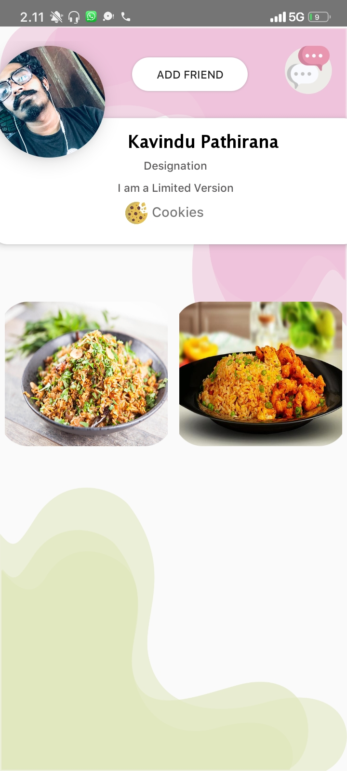

Manage Friends
Users can send the friend requests by clicking the “Add Friend” which is located on top of the user’s account.
At the same time, they can cancel the sent friend request by clicking the same button. And now the button has changed the status to “Cancel Request”

Slide 28
Let’s move into
Admin Panel Reports

Slide 29
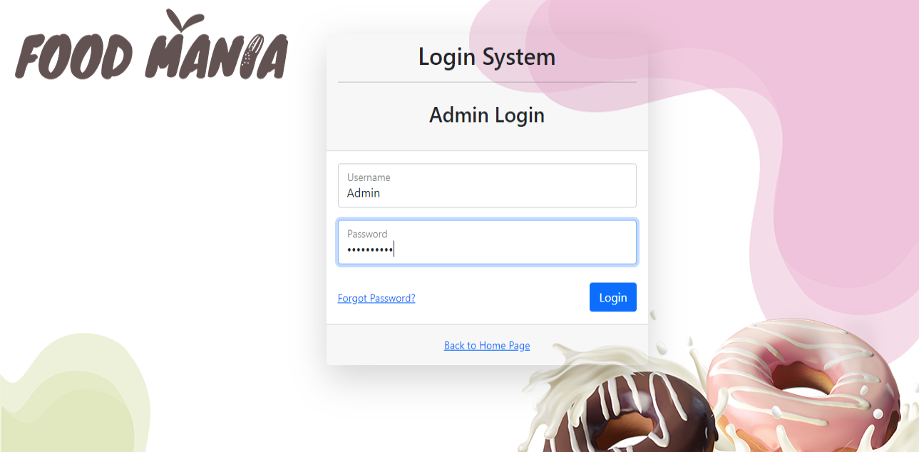
Admin Login
This is the admin panel content management system.
URL: http://foodmaniaapi.000webhostapp.com/
Admin users can login to the content management system by using their username and password.

Slide 30
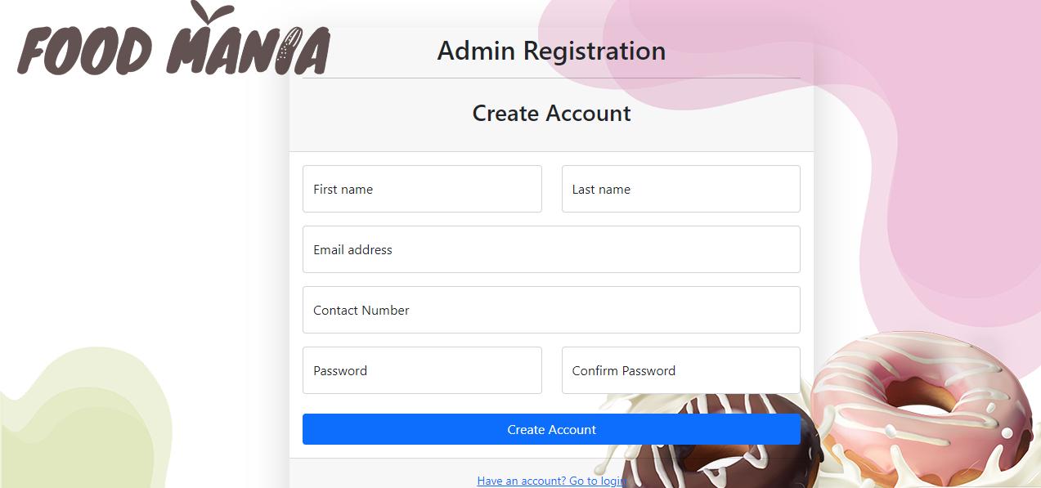
Admin Registration
New admins can register to the system through this .

Slide 31
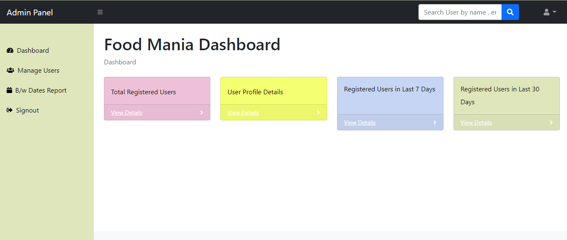
Admin Dashboard
Admin dashboard is displaying the dynamic reports of the food mania app.

Slide 32
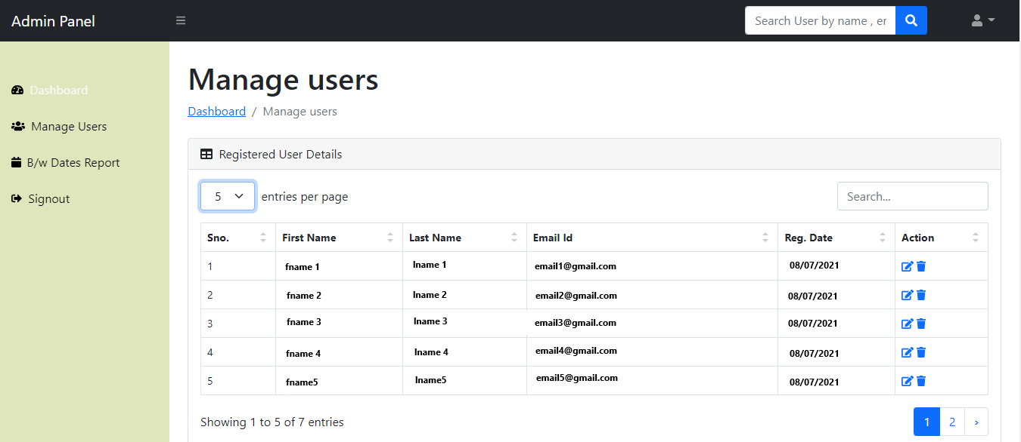
Manage Users
This report shows all the registered users in the system.

Slide 33
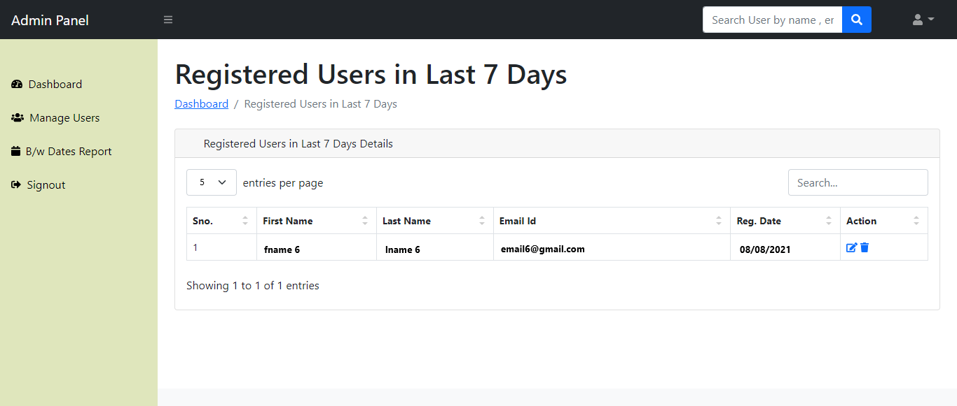
Registered Users Within 7 Days
This report shows registered users within last 7 days.

Slide 34
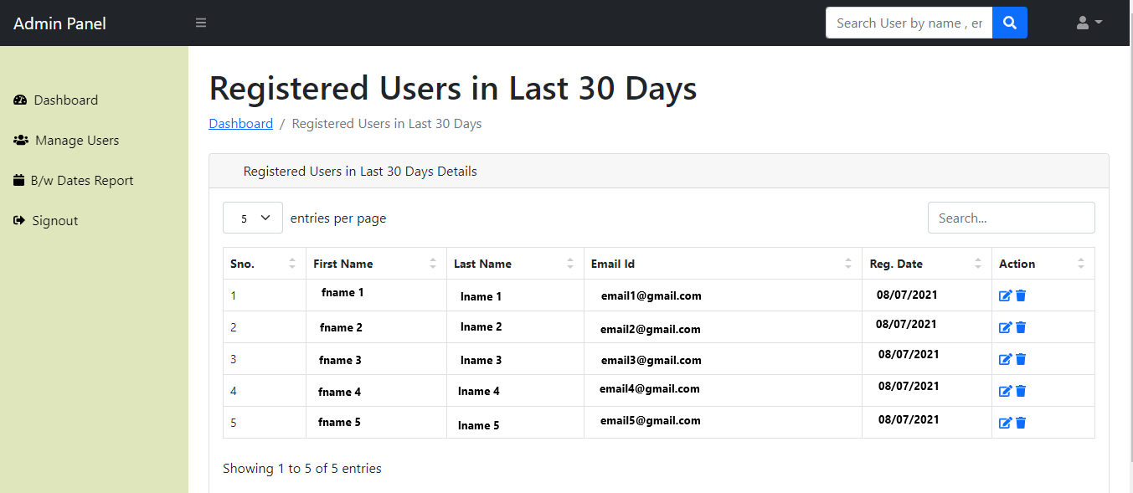
Registered Users Within 30 Days
This report shows registered users within 30 days.

Slide 35
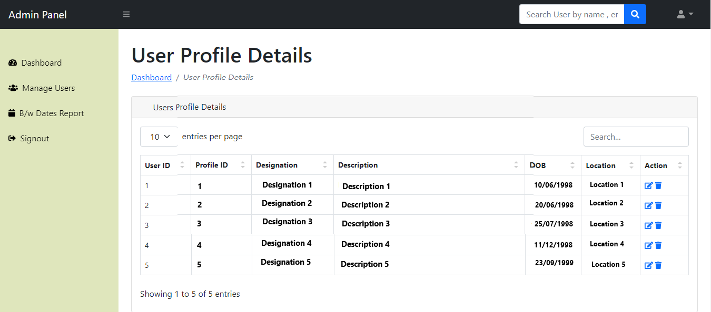
User Profile Details
This report shows all user profile details. .

Slide 36
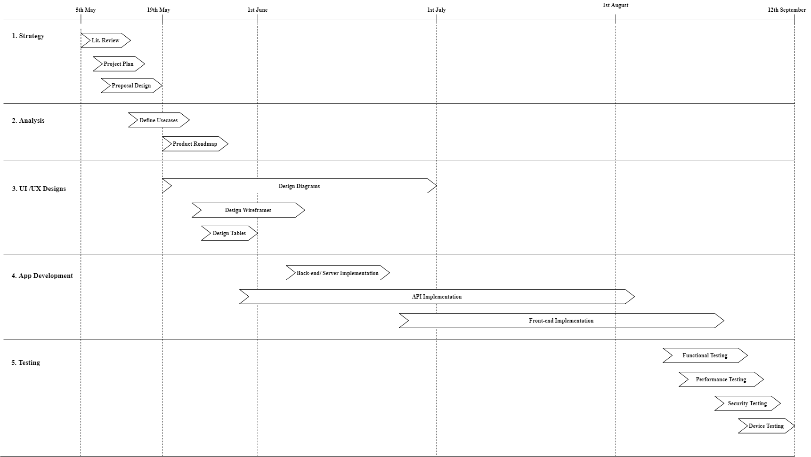
Implementation Plan

Slide 37

Conclusion
This system has been developed to be user-friendly. As mentioned in the introduction, we are trying to fulfill the lack of a social platform that provides all buying, selling, hiring, sharing food related things in one place. For that, we have developed a food-based social media app called “Food Mania”.
Users can create their own accounts and share food recipes, perform businesses activities (Restaurants, cake bakers, etc.), share photos, stories, videos, conduct classes and learning sessions via our video streaming feature and sell their cooking skills with their friends and followers, you care about.
This Application is full secured about your personal details because it will handle by an admin panel. The admin panel ensures the customers’ privacy policies. Plus, they maintain the reports of the system to be able to keep real-time supervision.

Slide 38
A.D.M.L. Aluthge COHDSE201F - 011
H.P.K.G. Pathirana COHDSE201F - 040
Y.D. Ranasinghe COHDSE201F - 041
V.T. Mohotti COHDSE201F - 042
Thank You !

